Slide 1

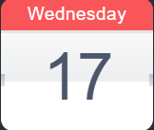
Gita rahasyam
Key Points:
Whom Am I?
Difference b/w living and non-living things
What happens at time of Death?
Does Reincarnation EXISTS?
Session -2
jiva
Speaker: Vasudev Krishna Sir
👉
👉
👉
Date – 17th January 2024
Time – 05:30 pm, Wednesday

